Slide 1
NBA Data Integration
Lorenzo Frangella - 1899674
Large Scale Data Management – Information Integration
Sapienza University of Rome

Slide 2
Table of contents
Datasets
Tasks
Preprocessing
I.I.S classification
Queries
Integration tool

Slide 3








Datasets content
Players
Teams
Fouls
Games
Awards
Coaches

Slide 4
Tasks
Retrieve all match played in 2018
Retrieve all the players that have played with Cleveland Cavaliers
Retrieve all the players that have played in a team trained by Herb Brown
Check if there is a Coach that was also a player
Retrieve all the season and teams that won the NBA with Kobe Bryant in their team
Retrieve players that has won at least two MVP Prizes

Slide 5
Preprocessing
In the dataset the teams are identified in three different ways: Full team name, a nickname or by a 3 lecters String. As example Boston Celtics, BOS and Celtics refers to the same team.
After the integration the only identifier for each team is the full name.
All the Names of teams and players are converted in lowercase.
All the dates are converted to a string of the format yyyyMMdd.

Slide 6
Classification of I.I.S.
Scope of the Integration Domain Integration System, system is developed to perform users-specified tasks/queries.
Result of the integration Result as Database, reconciled information can be represented as a relational database.
Mapping Specification Declarative, system defined on what information should be extracted (in FOL).
Representation of the Result Materialization, the result is loaded from the sources.

Slide 7
Source Schema
Data comes from 7 different datasets taken from Kaggle, the domain of all of them is the same: Basketball
10 files csv were used to perform integration, each csv file is considered as a table in the source schema.
NBA_PLAYERS(player)
PLAYER_PRIZES(season, award, player)
PLAYER_TEAM_SEASON(season, player, team)
TEAM_ABBREVIATION(name, abbreviation)
COACHES(coach, team)
MATCH_PLAYERS(home, away, game_id)

Slide 8
Source Schema
GAMES(game_id, home, date)
CHAMPIONS_NBA(year, team)
TEAMS(team)
EVENTS(home, away, committing, disadvantaged, date)

Slide 9






Global Schema
$$NBAPlayers_{/1}$$
nba_players(player)
$$Teams_{/1}$$
teams(team)
$$PlayerAward_{/3}$$
player_awards(season,award,player)
$$PlayedIn_{/3}$$
played_in(season, player, team)
$$Coaches_{/1}$$
coaches(coach)
$$HasTrained_{/2}$$
has_trained(team, coach)

Slide 10



Global Schema
$$Matches_{/3}$$
matches(home,away,date)
$$NBAChampions_{/2}$$
nba_champions(year, fullname)
$$Fouls_{/2}$$
fouls(committing, disadvantaged)

Slide 11
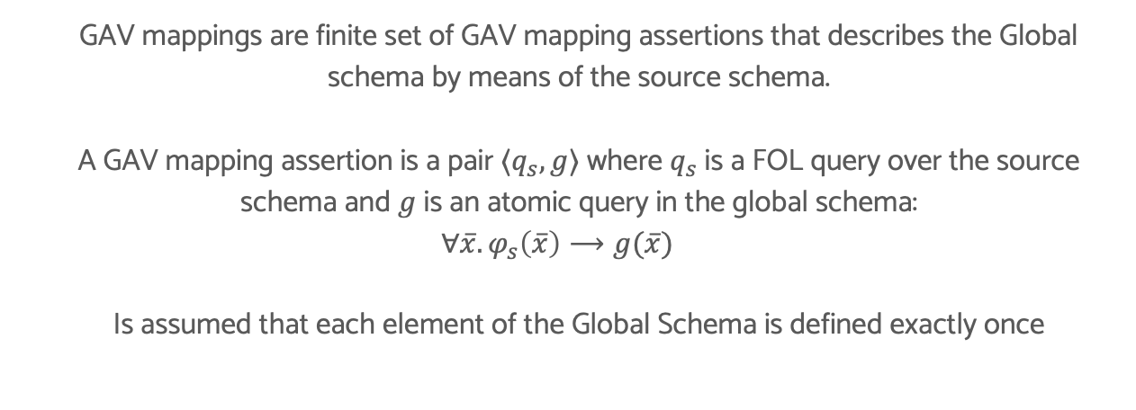
I.I.S. GAV MAPPING
GAV mappings are finite set of GAV mapping assertions that describes the Global schema by means of the source schema.
A GAV mapping assertion is a pair $⟨q_{s}, g⟩$ where $q_{s}$ is a FOL query over the source schema and $g$ is an atomic query in the global schema:
$$∀\overline{x}. φ_{s}\left(\overline{x}\right)⟶g(\overline{x})$$
Is assumed that each element of the Global Schema is defined exactly once

Slide 12
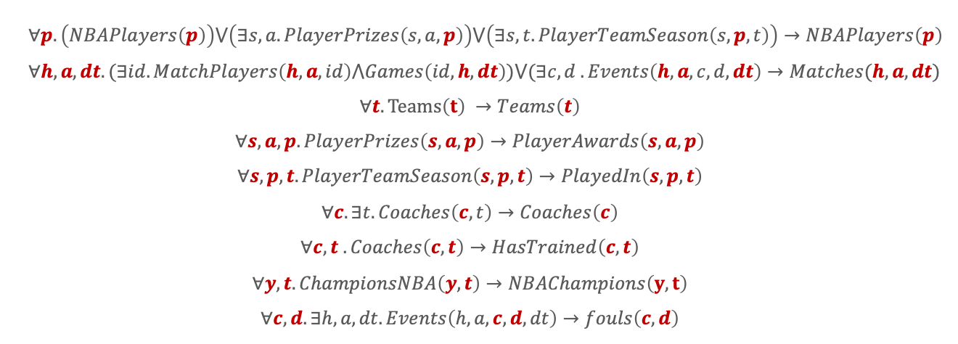
I.I.S GAV MAPPING ASSERTIONS
$$∀p. \left(NBAPlayers\left(p\right)\right)⋁\left(∃s,a.PlayerPrizes\left(s,a,p\right)\right)⋁\left(∃s,t. PlayerTeamSeason\left(s,p,t\right)\right)→NBAPlayers\left(p\right)$$
$$∀h,a,dt. (∃id.MatchPlayers\left(h,a,id\right)⋀Games\left(id,h,dt\right))⋁(∃c,d .Events\left(h,a,c,d,dt\right)→Matches(h,a,dt)$$
$$∀t. Teams\left(t\right) →Teams\left(t\right)$$
$$∀s,a,p. PlayerPrizes\left(s,a,p\right)→PlayerAwards\left(s,a,p\right)$$
$$∀s,p,t.PlayerTeamSeason\left(s,p,t\right)→PlayedIn\left(s,p,t\right)$$
$$∀c. ∃t.Coaches\left(c,t\right)→Coaches\left(c\right)$$
$$∀c,t . Coaches\left(c,t\right)→HasTrained\left(c,t\right)$$
$$∀y,t.ChampionsNBA\left(y,t\right)→NBAChampions\left(y,t\right)$$
$$∀c,d. ∃h,a,dt. Events\left(h,a,c,d,dt\right)→fouls\left(c,d\right)$$

Slide 13
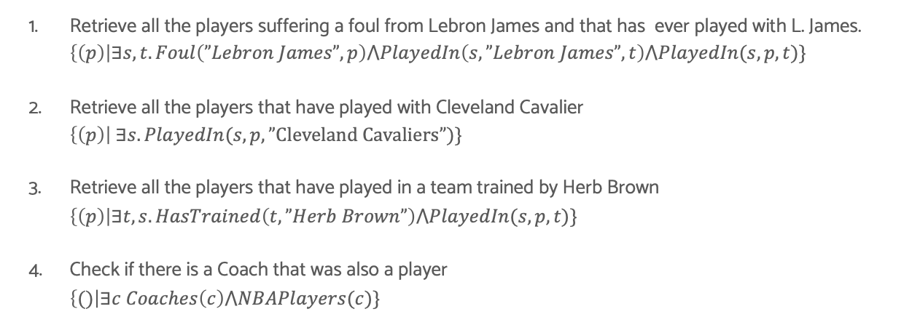
Queries
Retrieve all the players suffering a foul from Lebron James and that has ever played with L. James. $\left\{\left(p\right)\right|∃s,t. Foul\left(”Lebron James”,p\right)⋀PlayedIn\left(s,”Lebron James”,t\right)⋀PlayedIn(s,p,t)\}$
Retrieve all the players that have played with Cleveland Cavalier $\left\{\left(p\right)\right| ∃s. PlayedIn(s,p, ”Cleveland Cavaliers”)\}$
Retrieve all the players that have played in a team trained by Herb Brown $\left\{\left(p\right)\right|∃t,s.HasTrained\left(t,”Herb Brown”\right)⋀PlayedIn(s,p,t)\}$
Check if there is a Coach that was also a player $\left\{()\right|∃c Coaches\left(c\right)⋀NBAPlayers(c)\}$

Slide 14

Queries
Retrieve all the season and teams that won the NBA with Kobe Bryant in their team $\left\{\left(s,t\right)\right| NBAChampions(s,t)⋀PlayedIn(s,”Kobe Bryant”,t)\}$
Retrieve players that has won at least two MVP Prizes (won the mvp prize in two different seasons) $\left\{\left(p\right)\right|∃s1,s2 PlayerAward\left(s1,”nba mvp”,p\right)⋀PlayerAward\left(s2,”nba mvp”,p\right)⋀s1≠s2\}$

Slide 15
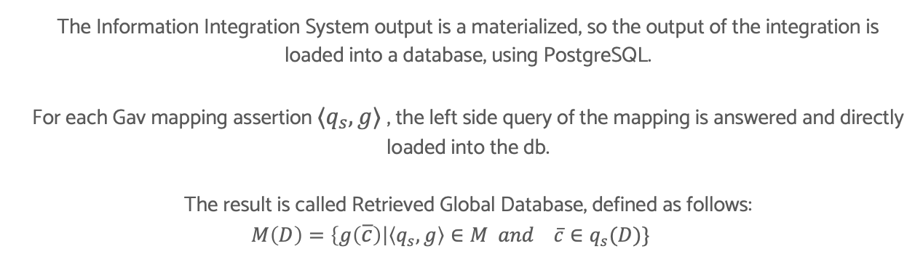
Materializaion approach - output
The Information Integration System output is a materialized, so the output of the integration is loaded into a database, using PostgreSQL.
For each Gav mapping assertion $⟨q_{s}, g⟩$ , the left side query of the mapping is answered and directly loaded into the db.
The result is called Retrieved Global Database, defined as follows:
$$M\left(D\right)=\left\{g\left(\overline{c}\right)\right|\left\langle q_{s}, g\right\rangle ∈M and \overline{c}∈q_{s}(D)\}$$

Slide 16
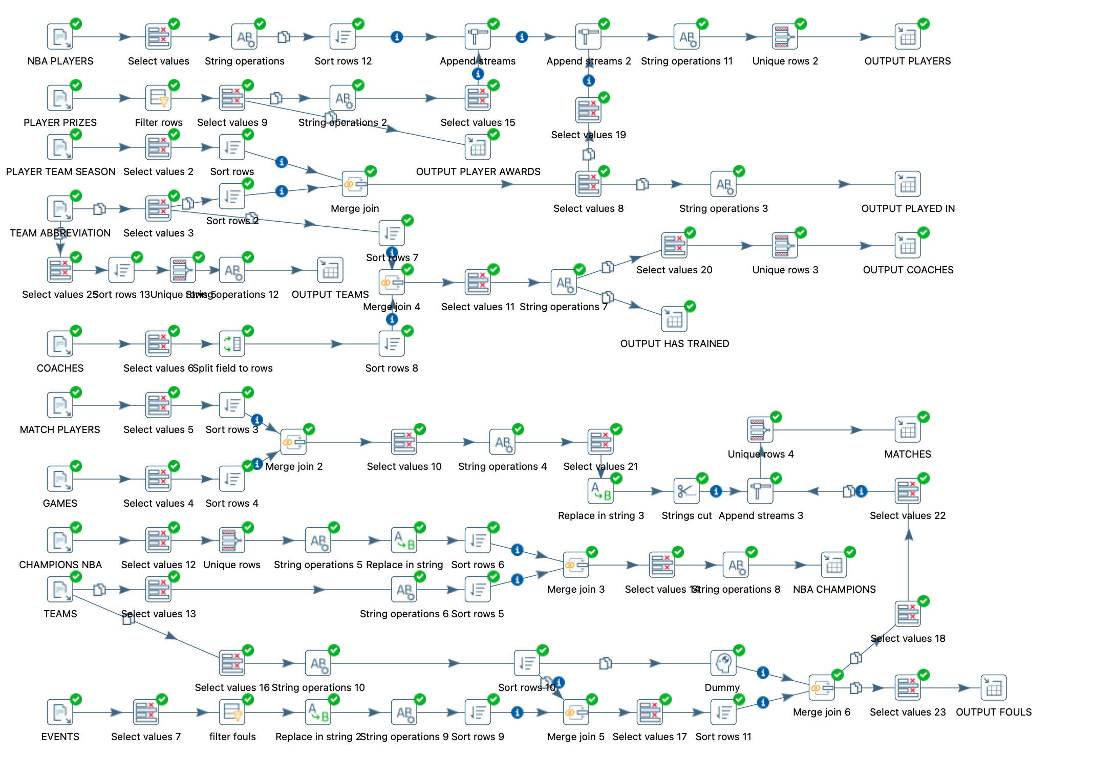
Integration Implementation - Pentaho

Slide 17
References
Papers:
Images:
https://www.flaticon.com
Slides:
https://github.com/pietro-nardelli/sapienza-ppt-template [Attribution-NonCommercial-ShareAlike 4.0 International (CC BY-NC-SA 4.0)]
Presentation Title - Name Surname

Slide 18
Thank you for the attention!

